Slide 1
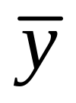
Chap. 5, 6: Statistical inference methods
Chapter 5: Estimation (of population parameters)
Ex. “Based on GSS data, we’re 95% confident that the population mean of the variable LONELY (no. of days in past week you felt lonely, = 1.5, s = 2.2) falls between 1.4 and 1.6.
Chapter 6: Significance Testing (Making decisions about hypotheses regarding “effects” and associations)
Ex. Article in Science, 2008: “We hypothesized that spending money on other people has a more positive impact on happiness than spending money on oneself.”

Slide 2
5. Statistical Inference: Estimation
Goal: How can we use sample data to estimate values of population parameters?
Point estimate: A single statistic value that is the “best guess” for the parameter value
Interval estimate: An interval of numbers around the point estimate, that has a fixed “confidence level” of containing the parameter value. Called a confidence interval.
(Based on sampling distribution of the point estimate)

Slide 3
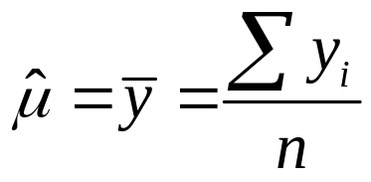
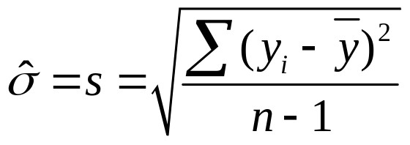

Point Estimators – Most common to use sample values
Sample mean estimates population mean μ
Sample std. dev. estimates population std. dev. σ
Sample proportion estimates population proportion 

Slide 4
Properties of good estimators
Unbiased: Sampling distribution of the estimator centers around the parameter value
ex. Biased estimator: sample range. It cannot be larger than population range.
Efficient: Smallest possible standard error, compared to other estimators
Ex. If population is symmetric and approximately normal in shape, sample mean is more efficient than sample median in estimating the population mean and median. (can check this with sampling distribution applet at www.prenhall.com/agresti)
Notes:
Maximum likelihood gives good point estimates

Slide 5
Confidence Intervals
A confidence interval (CI) is an interval of numbers believed to contain the parameter value.
The probability the method produces an interval that contains the parameter is called the confidence level. Most studies use a confidence level close to 1, such as 0.95 or 0.99.
Most CIs have the form
point estimate ± margin of error
with margin of error based on spread of sampling distribution of the point estimator;
e.g., margin of error  2(standard error) for 95% confidence.

Slide 6
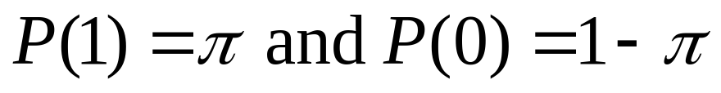
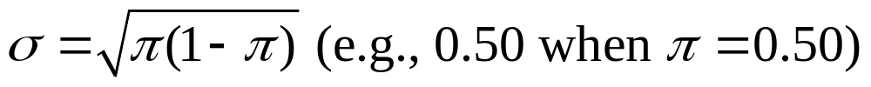
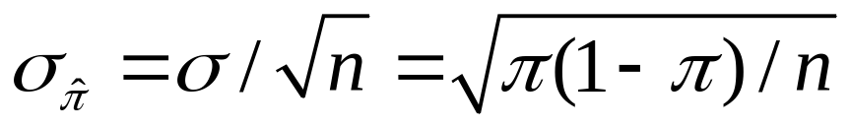
Confidence Interval for a Proportion
(in a particular category)
Recall that the sample proportion is a mean when we let
y = 1 for observation in category of interest, y = 0 otherwise
Recall the population proportion is mean µ of prob. dist having
The standard deviation of this probability distribution is
The standard error of the sample proportion is

Slide 7
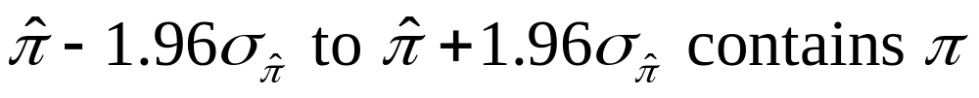
The sampling distribution of a sample proportion for large random samples is approximately normal
(Central Limit Theorem)
So, with probability 0.95, sample proportion falls within 1.96 standard errors of population proportion 
0.95 probability that
Once sample selected, we’re 95% confident
This is the CI for the population proportion  (almost)

Slide 8
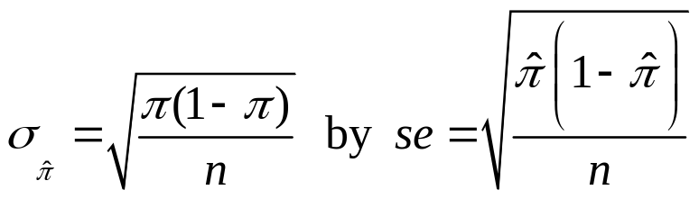

Finding a CI in practice
Complication: The true standard error
itself depends on the unknown parameter!
In practice, we estimate
and then find the 95% CI using the formula

Slide 9
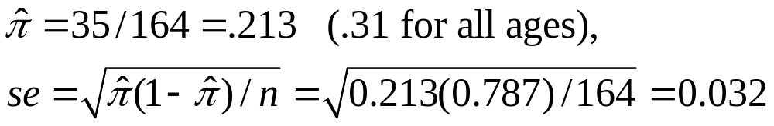
Example: What percentage of 18-22 year-old Americans report being “very happy”?
Recent GSS data: 35 of n = 164 say they are “very happy”
(others report being “pretty happy” or “not too happy”)
95% CI is 0.213 ± 1.96(0.032), or 0.213 ± 0.063,
(i.e., “margin of error” = 0.063)
which gives (0.15, 0.28). We’re 95% confident the population proportion who are “very happy” is between 0.15 and 0.28.

Slide 10
Find a 99% CI with these data
0.99 central probability, 0.01 in two tails
0.005 in each tail
z-score is 2.58
99% CI is 0.213 ± 2.58(0.032),
or 0.213 ± 0.083, which gives (0.13, 0.30)
Greater confidence requires wider CI
Recall 95% CI was (0.15, 0.28)

Slide 11
Suppose sample proportion of 0.213 was based on n = 656 (instead of 164)
95% CI is 0.213 ± 1.96(0.016), or 0.213 ± 0.031,
which is (0.18, 0.24).
Recall 95% CI with n = 164 was (0.15, 0.28)
Greater sample size gives narrower CI
(quadruple n to halve width of CI)
These se formulas treat population size as infinite
(see Exercise 4.57 for finite population correction)

Slide 12
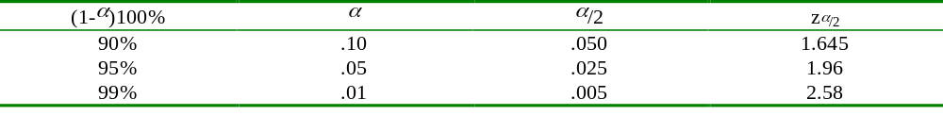
Some comments about CIs
Effects of n, confidence coefficient true for CIs for other parameters also
If we repeatedly took random samples of some fixed size n and each time calculated a 95% CI, in the long run about 95% of the CI’s would contain the population proportion .
(CI applet at www.prenhall.com/agresti)
The probability that the CI does not contain  is called the error probability, and is denoted by .
 = 1 – confidence coefficient

Slide 13
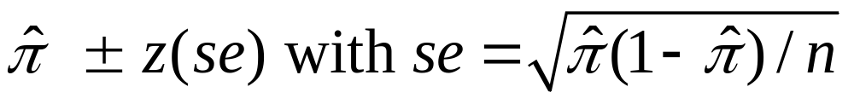
General formula for CI for proportion is
z-value such that prob. for a normal dist within z standard errors of mean equals confidence level
(e.g., z=1.96 for 95% confidence, z=2.58 for 99% conf.)
With n for most polls (roughly 1000), margin of error usually about ± 0.03 (ideally)
Method requires “large n” so sampling distribution of sample proportion is approximately normal (CLT) and estimate of true standard error is decent
In practice, ok if at least 15 observations in the category of interest and at least 15 observations not in it.
(ex. n=164, 35 “very happy”, 164 – 35 = 129 not “very happy”, condition satisfied)

Slide 14
Otherwise, sampling distribution is skewed
(can check this with sampling distribution applet at www.prenhall.com/agresti, e.g., for n = 30 but  = 0.1 or 0.9)
and sample proportion may then be poor estimate of , and se may then be a poor estimate of true standard error.
Example: Estimating proportion of vegetarians (p. 129)
n = 20, 0 vegetarians, sample proportion = 0/20 = 0.0,
95% CI for population proportion is 0.0 ± 1.96(0.0), or (0.0, 0.0)
Better CI method (due to Edwin Wilson at Harvard in 1927, but not in most statistics books):
Rather than estimating the standard error, figure out  values for which

Slide 15
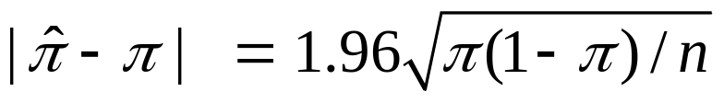

Example: for n = 20 with
solving the quadratic equation this gives for  provides solutions 0 and 0.16, so 95% CI is (0, 0.16)
Agresti and Coull (1998) suggested using ordinary CI, estimate ± z(se), after adding 2 observations of each type. This simpler approach works well even for very small n
(95% CI has same midpoint as Wilson CI);
Example: 0 vegetarians, 20 non-vegetarians
Change to 2 veg, 22 non-veg, and then we find
95% CI is 0.08 ± 1.96(0.056) = 0.08 ± 0.11, gives (0.0, 0.19).

Slide 16
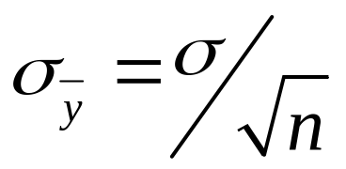
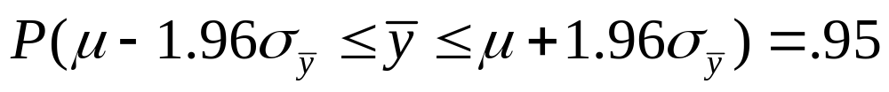
Confidence Interval for the Mean
In large random samples, the sample mean has approximately a normal sampling distribution with mean μ and standard error
Thus,
We can be 95% confident that the sample mean lies within 1.96 standard errors of the (unknown) population mean

Slide 17
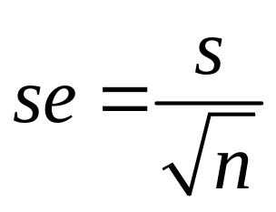
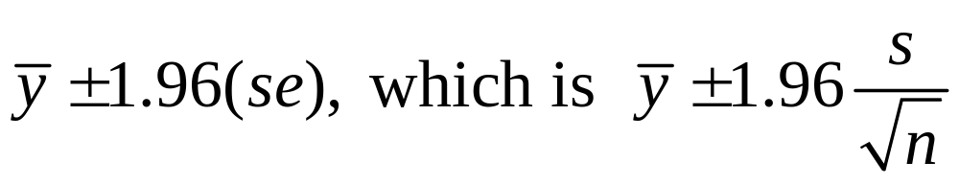
Problem: Standard error is unknown (σ is also a parameter). It is estimated by replacing σ with its point estimate from the sample data:
95% confidence interval for μ :
This works ok for “large n,” because s then a good estimate of σ (and CLT applies). But for small n, replacing σ by its estimate s introduces extra error, and CI is not quite wide enough unless we replace z-score by a slightly larger “t-score.”

Slide 18
The t distribution (Student’s t)
Bell-shaped, symmetric about 0
Standard deviation a bit larger than 1 (slightly thicker tails than standard normal distribution, which has mean = 0, standard deviation = 1)
Precise shape depends on degrees of freedom (df). For inference about mean,
df = n – 1
Gets narrower and more closely resembles standard normal distribution as df increases
(nearly identical when df > 30)
CI for mean has margin of error t(se),
(instead of z(se) as in CI for proportion)

Slide 19
Part of a t table
Confidence Level
90% 95% 98% 99%
df t.050 t.025 t.010 t.005
1 6.314 12.706 31.821 63.657
1.812 2.228 2.764 3.169
16 1.746 2.120 2.583 2.921
30 1.697 2.042 2.457 2.750
100 1.660 1.984 2.364 2.626
infinity 1.645 1.960 2.326 2.576
df =  corresponds to standard normal distribution

Slide 20
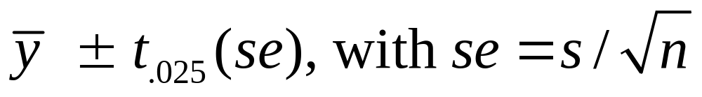
CI for a population mean
For a random sample from a normal population distribution, a 95% CI for µ is
where df = n - 1 for the t-score
Normal population assumption ensures sampling distribution has bell shape for any n (Recall figure on p. 93 of text and next page). More about this assumption later.

Slide 21
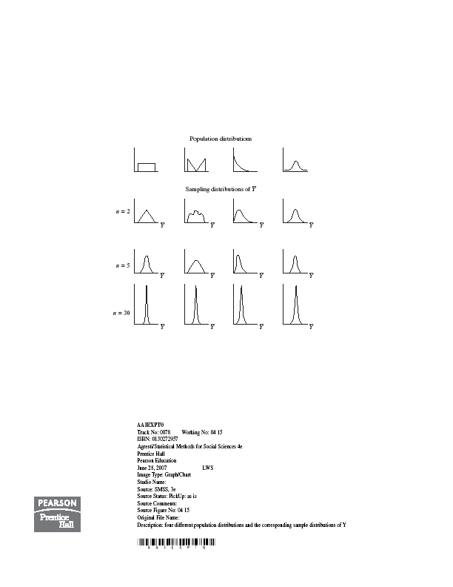

Slide 22
Example: Anorexia study (p.120)
Weight measured before and after period of treatment
y = weight at end – weight at beginning
Example on p.120 shows results for “cognitive behavioral” therapy. For n=17 girls receiving “family therapy” (p. 396),
y = 11.4, 11.0, 5.5, 9.4, 13.6, -2.9, -0.1, 7.4, 21.5, -5.3, -3.8, 13.4, 13.1, 9.0, 3.9, 5.7, 10.7

Slide 23
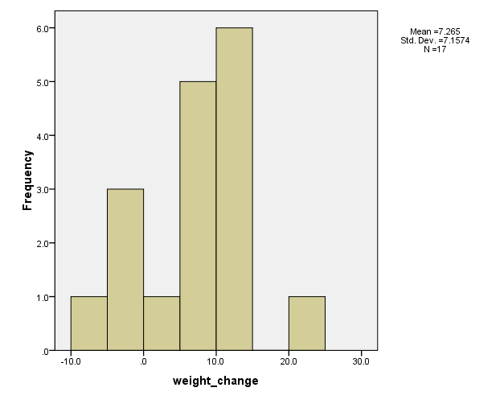

Slide 24
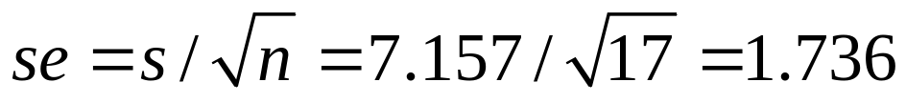
SPSS: Analyze -> compare means -> 1-sample t test
---------------------------------------------------------------------------------------
Variable N Mean Std.Dev. Std. Error Mean
weight_change 17 7.265 7.157 1.736
----------------------------------------------------------------------------------------
se obtained as
Since n = 17, df = 16, t-score for 95% confidence is 2.12
SPSS: Transform -> compute variable -> idf.t(.025,16)
95% CI for population mean weight change is
We can predict that the population mean weight change µ is positive (i.e., the treatment is effective, on average), with value of µ between about 3.6 and 10.9 pounds.

Slide 25
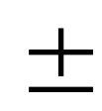
Example: TV watching in U.S.
GSS asks “On average day, how many hours do you personally watch TV?”
For n = 899, = 2.865, s = 2.617
What is a 95% CI for population mean?
df = n-1 = 898 huge, so t-score essentially same as z = 1.96
Show se = 0.0873, CI is 2.865 0.171, or (2.69, 3.04)
Interpretation?

Slide 26
Multiple choice:
We can be 95% confident the sample mean is between 2.69 and 3.04.
95% of the population watches between 2.69 and 3.04 hours of TV per day
We can be 95% confident the population mean is between 2.69 and 3.04
If random samples of size 899 were repeatedly selected, in the long run 95% of them would contain = 2.865
Note: The t method for CIs assumes a normal population distribution. Do you think that holds here?

Slide 27
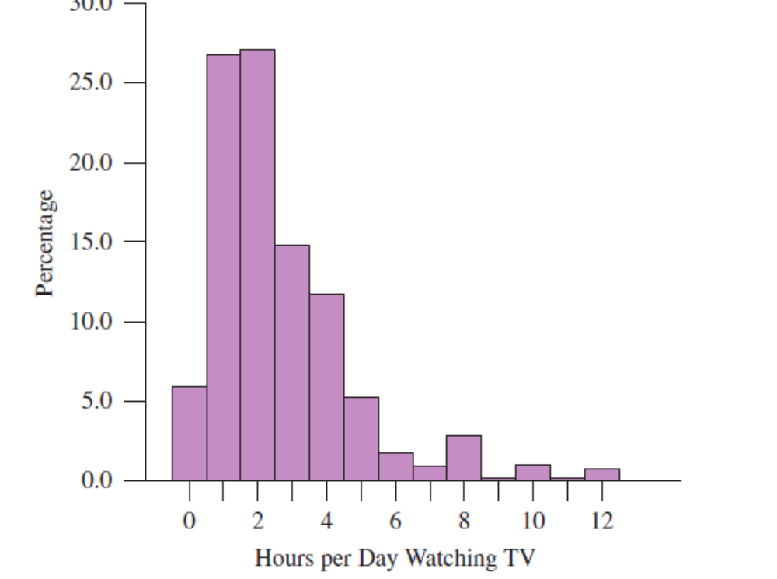

Slide 28
Comments about CI for population mean µ
The method is robust to violations of the assumption of a normal population dist.
(But, be careful if sample data dist is very highly skewed, or if severe outliers. Look at the data.)
Greater confidence requires wider CI
Greater n produces narrower CI
t methods developed by the statistician William Gosset of Guinness Breweries, Dublin (1908)

Slide 29

Because of company policy forbidding the publication of company work in one’s own name, Gosset used the pseudonym Student in articles he wrote about his discoveries (sometimes called “Student’s t distribution”)
He was given only small samples of brew to test (why?), and realized he could not use normal z-scores after substituting s in standard error formula.

Slide 30
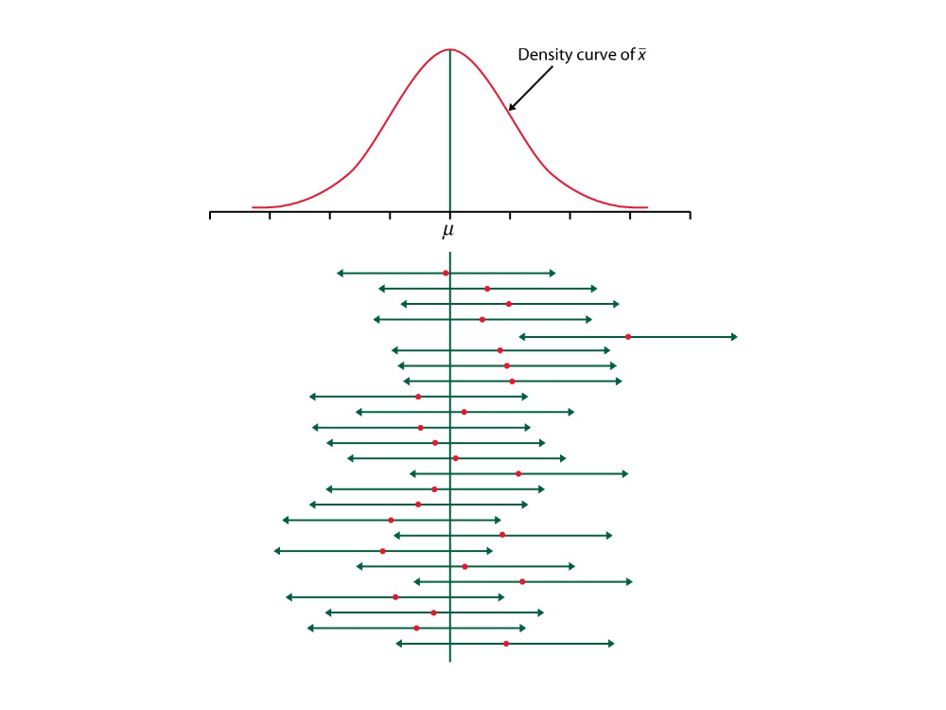
In the “long run,” 95% of 95% CIs for a population mean μ will actually cover μ
(In graph, each line shows a CI for a particular sample with its own sample mean, taken from the sampling distribution curve of possible sample means)

Slide 31
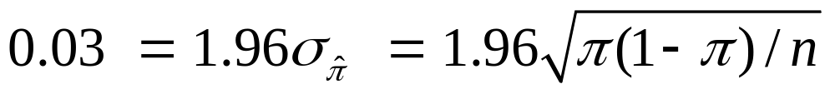
Choosing the Sample Size
Ex. How large a sample size do we need to estimate a population proportion (e.g., “very happy”) to within 0.03, with probability 0.95?
i.e., what is n so that margin of error of 95% confidence interval is 0.03?
Set 0.03 = margin of error and solve for n

Slide 32
Solution
Largest n value occurs for  = 0.50, so we’ll be “safe” by selecting n = 4268(0.50)(0.50) = 1067.
If only need margin of error 0.06, require
(To double precision, need to quadruple n)

Slide 33
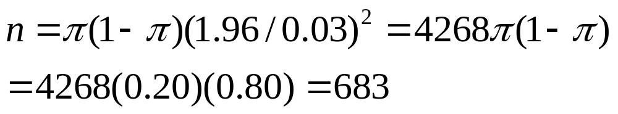
What if we can make an educated “guess” about proportion value?
If previous study suggests population proportion is roughly about 0.20, then to get margin of error 0.03 for 95% CI,
(instead of n = 1067)
It’s “easier” to estimate a population proportion as the value gets closer to 0 or 1 (close election,  near 0.50, difficult)
Better to use approx value for  rather than 0.50 unless you have no idea about its value.

Slide 34
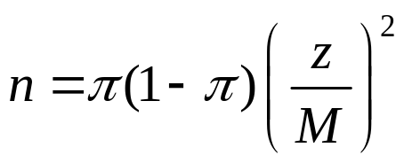
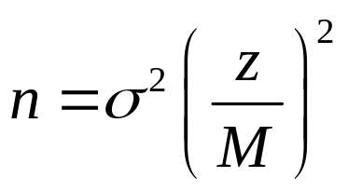
Choosing the Sample Size
Determine parameter of interest (population mean or population proportion)
Select a margin of error (M) and a confidence level (determines z-score)
Proportion (to be “safe,” set π = 0.50):
Mean (need a guess for value of σ):

Slide 35
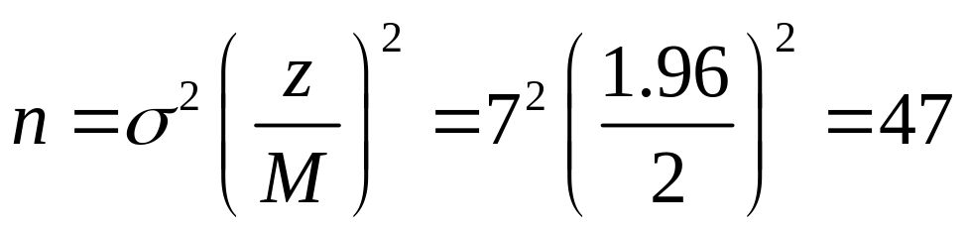
Example: n for estimating mean
Future anorexia study: We want n to estimate population mean weight change to within 2 pounds, with probability 0.95.
Based on past study, guess σ = 7
Note: Don’t worry about memorizing formulas such as for sample size. Formula sheet given on exams.

Slide 36
Some comments about CIs and sample size
We’ve seen that n depends on confidence level (higher confidence requires larger n) and the population variability (more variability requires larger n)
In practice, determining n not so easy, because (1) many parameters to estimate, (2) resources may be limited and we may need to compromise
CI’s can be formed for any parameter.
(e.g., see pp. 130-131 for CI for median)

Slide 37

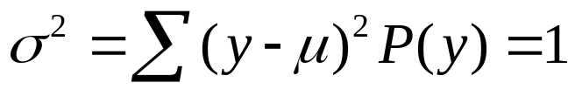
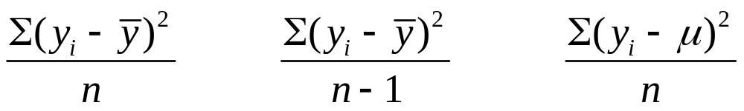
Using n-1 (instead of n) in s² reduces bias in the estimation of the population variance σ²
Example: A binary probability distribution with n = 2
y P(y)
0 ½ µ = 1,
2 ½
Possible samples
(equally likely)
(0, 0) 0 0 1
(0, 2) 1 2 1
(2, 0) 1 2 1
(2, 2) 0 0 1
Mean of estimates 0.5 1.0 1.0

Slide 38
Confidence interval methods were developed in the 1930s by Jerzy Neyman (U. California, Berkeley) and Egon Pearson (University College, London)
The point estimation method mainly used today, developed by Ronald Fisher (UK) in the 1920s, is maximum likelihood. The estimate is the value of the parameter for which the observed data would have had greater chance of occurring than if the parameter equaled any other number.
(picture)
The bootstrap is a modern method (Brad Efron) for generating CIs without using mathematical methods to derive a sampling distribution that assumes a particular population distribution. It is based on repeatedly taking samples of size n (with replacement) from the sample data distribution.

Slide 39
Using CI Inference in Practice (or in HW)
What is the variable of interest?
quantitative – inference about mean
categorical – inference about proportion
Are conditions satisfied?
Randomization (why? Needed so sampling dist. and its
standard error are as advertised)
Other conditions?
Mean: Look at data to ensure distribution of data not such that
mean is irrelevant or a misleading parameter
Proportion: Need at least 15 observ’s in category and not in
category, or else use different formula (e.g., Wilson’s
approach, or first add 2 observations to each category)

